Slide 1
Software Requirements

Slide 2

Contents
Critical role of Requirements in a Project
Definition of Requirements Terms
Desirable characteristics of Requirements
Overview of Requirements Engineering activities

Slide 3
Definition of a Requirement
IEEE Standard Glossary of SW Engineering Terminology 1997.
A condition or capability needed by a user to solve a problem or achieve an objective.
A condition or capability that must be met or possessed by a system component to satisfy a contract, standard, specification or other formally imposed document.
A documented representation of a condition or capability as in 1 or 2.

Slide 4
Study of SW Projects shows …
A study by the Standish Group (1994) of Projects carried out in the United States
  three most commonly cited factors that caused project failure were:-
    Lack of user input : 13% of all projects
    Incomplete requirements: 12% of projects
    Changing requirements: 12% of all projects
Many projects fail due to reasons that are directly related to shortcomings in requirements processes (elicitation, analysis, verification, specification, management).

Slide 5

Cost of Fixing Requirements Errors
Requirements errors top the delivered defects.
Requirements errors are the most costly to fix if discovered late ie. during maintenance phase
  If a unit cost of 1 is assigned to the effort required to detect and repair an error during the coding stage, then the cost to detect and repair an error during the requirements stage is between 5-10 times less.
  The cost to detect and repair an error during the maintenance phase is 20 times more, due to rework of work products of (design, code, test cases, user documentation).
It is most economical to detect and fix as many requirements errors during requirements phase itself.

Slide 6
Requirements Activities are Crucial in a Project
“The hardest single part of building a SW system is deciding precisely what to build. No other part of the conceptual work is as difficult as establishing the detailed technical requirements, including all the interfaces to people, to machines, and to other SW systems. No other part of the work so cripples the resulting system if done wrong. No other part is more difficult to rectify later.”
-- Frederick Brooks [ 1987, Essay: No Silver Bullet: Essence and Accidents of SW Engineering]

Slide 7
SW Requirements Phase
Case-1: Only SW Product
development
Case-2: System development
involves SW + HW Products
System
requirements
Software
requirements
System design
Software
design
Hardware
requirements
Software
requirements
.
.
.
Software
design
Software
design
.
.
.
.
.
.

Slide 8
Levels of SW Requirements
Represent high-level objectives of the organization or customer requesting the product.
Captured in Project’s Vision & Scope document.
Business
Requirements
User
Requirements
Functional
Requirements

Slide 9
Project Vision & Scope Document
Description of the business opportunity, the project’s vision and objectives, a statement of product scope and limitations, some characterization of the customers, project priorities, and a description of project success factors.
A relatively short document, about 3-8 pages, depending on the nature and size of the project.
Purpose
  gives all project participants a common understanding of the project objectives
  Serves as a basis for assessing new requirements for inclusion in the project.

Slide 10
Levels of SW Requirements
Describe the tasks the users must be able to accomplish with the product.
Captured in Use cases or scenario descriptions.
User requirements must align with the system’s business requirements.
Business
Requirements
User
Requirements
Functional
Requirements

Slide 11
Levels of SW Requirements
Defines the SW functionality the developers must build into the product to enable users to accomplish their tasks, thereby satisfying the business requirements.
Documented in a Software Requirements Specification (SRS) document.
A feature
  is a set of logically related functional requirements that provides a capability to the user and enables satisfaction of a business requirement.
Business
Requirements
User
Requirements
Functional
Requirements

Slide 12
Other Types of SW Requirements
In addition to functional requirements, the following other types of requirements are also documented in the SRS:
  Non-functional Requirements
  Quality Attributes
  Design constraints

Slide 13
Non-Functional Requirements
Standards, regulations and contracts to which the product must conform
Descriptions of external interfaces
  User interfaces, HW interfaces, SW interfaces
Performance requirements
Quality Attributes

Slide 14
Quality Attributes
Augment the description of the product’s functionality by describing the product’s quality characteristics in various dimensions that are important either to users or to developers.
Such as:
  Usability, Reliability, Maintainability, Portability, etc.

Slide 15
Design Constraints
Customer requirements that place restrictions on the choices available to the developer for design and construction of the SW Product.

Slide 16
Desirable Requirements Statement Characteristics
Complete
  Each requirement must fully describe the functionality to be delivered.
  It must contain all the information necessary for the developer to design and implement that functionality.
Correct
  Each requirement must accurately describe the functionality to be built.
  The reference for correctness is the source of the requirement, such as a customer or a high-level system requirements specification.

Slide 17
Desirable Requirements Statement Characteristics
Feasible
  It must be possible to implement each requirement within the known capabilities and limitations of the system and its environment.
  A member of the SE team can work with marketing or the requirements analysts throughout the elicitation process to provide a reality check on what can and cannot be done technically, and what can be done only at excessive cost.
Necessary
  Each requirement should document something that the customers really need or something that is required for conformance to an external system requirement or standard.

Slide 18
Desirable Requirements Statement Characteristics
Prioritized
  Assign an implementation priority to each requirement to indicate how essential it is to a particular product release.
Unambiguous
  Each requirement should have a single, consistent interpretation of it.
  Hold formal inspections of SRS, write test cases, develop prototypes, devise usage scenarios to remove ambiguity.

Slide 19
Desirable Requirements Statement Characteristics
Verifiable
  Examine each requirement to see whether you can devise a small number of tests or use other verification approaches, such as inspection or demonstration, to determine whether the requirement was properly implemented in the product.

Slide 20
Desirable Requirements Specification Characteristics
Complete
  No requirements or necessary information should be missing.
  Focusing on user tasks, rather than on system functions, can help to prevent incompleteness.
Consistent
  Requirements should not conflict with other SW requirements or with high-level (system or business) requirements.

Slide 21
Desirable Requirements Specification Characteristics
Modifiable
  You must be able to revise the SRS when necessary and maintain a history of changes made to each requirement.
  Uniquely label each requirement, add a Table-of-contents, and cross-reference list to make the SRS easier to modify.
Traceable
  You should be able to link each SW requirement to its origin (back traceability) and to the design elements, source code and test cases that implement and verify the correct implementation of the requirement (forward traceability).

Slide 22
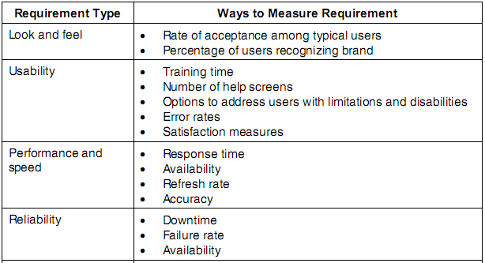
Examples of types of requirements and ways to quantify them

Slide 23
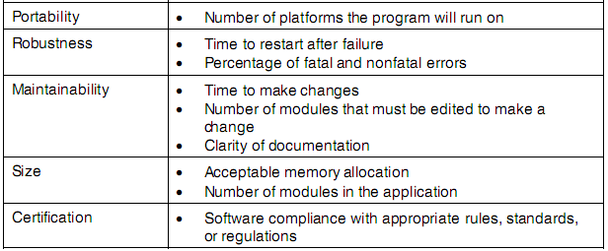
Examples of types of requirements and ways to quantify them

Slide 24
Requirements Process

Slide 25

Requirements Process
The requirements process takes a business or engineering problem and, from it, creates the specifications for a system that will provide a solution to that problem.

Slide 26
Requirements Engineering
Requirements Engineering
Requirements Development
Requirements Management
Elicitation
Analysis
Specification
Verification

Slide 27
Requirements Elicitation
  Is the process of identifying and understanding the needs and constraints of the different user classes for a proposed SW product.
Requirements Analysis
  Involves refining, analyzing, and scrutinizing the gathered requirements to make sure all stakeholders understand what they mean and to find errors, omissions, or other deficiencies.
  The goal is to develop requirements of sufficient quality and detail that you can use them to construct realistic project estimates and to proceed with design, construction and testing.

Slide 28
Requirements Specification
  the process of documenting the requirements in some consistent, accessible, and reviewable way.
Requirements Verification
  activities ensure that requirements statements are accurate, complete and demonstrate the qualities of good requirements statements.
  Involves performing informal and formal requirements document reviews, designing functional test cases based on a stable set of requirements.

Slide 29
Requirements Management
  Includes all activities that maintain the integrity and accuracy of the requirements agreement as the project progresses.
  Involves controlling changes to the requirements baseline, keeping project plans, products and activities consistent with the software requirements.
    Change control
    Version control
    Requirements tracing
    Requirements status tracking

Slide 30
Iterative nature of Requirements development
Elicitation, analysis, specification, and verification don’t take place in a tidy linear sequence: these activities are interleaved, incremental, and iterative.

Slide 31
Role of Requirements in a Project
Project
Planning
Design &
Implementation
Project Tracking and Control
Software
Requirements
User Documentation
Change Control Process
System Testing

Slide 32
Typical Stakeholders
Typical stakeholder groups include:
• Users who will operate the soft
• Customers who have requested the software or who represent the target market.
• Market analysts who determine the external market need and who may act as proxy customers.
• Regulators, which are representatives of third-party regulatory agencies.

Slide 33
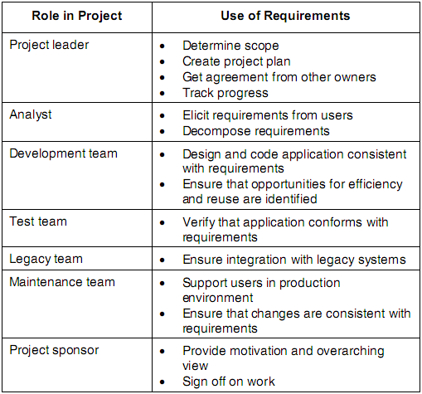
Project Stakeholders and Use of Requirements

Slide 34
Role of Requirements in a Project
Requirements provide the foundation for both the SW Engineering and Project management activities.
It is in the Requirements Process that the interests of all the Project stakeholders in a SW Project intersect.
Project Stakeholders
  Customers, Users, Business or Requirements Analysts, Developers, Testers, Authors of User documentation, Project Managers, and Customer Managers.
All the Stakeholders must be committed to following an effective requirements process for the project to be a success.

Slide 35
Risks From Inadequate Requirements Processes
Insufficient user involvement
  leads to unacceptable products
Scope creep
  creeping user requirements handled in an adhoc manner contribute to overruns in schedule, cost, resources and degrade product quality
Ambiguous requirements
  lead to wasted time and rework (as much as 40% of total development costs, and 70-80% of the total revisions can be attributed to requirements errors.)

Slide 36
Risks From Inadequate Requirements Processes
Gold-plating (adding unnecessary features)
  too often Users don’t find this functionality useful, and the effort spent on implementing it is wasted.
Minimal Requirements specifications
  lead to missing key requirements, frustrated developers and angry customers
Overlooked User classes
  leads to dissatisfied customers
Incompletely defined requirements
  make accurate project planning and tracking impossible

Slide 37
What we have covered ?

